Slide 1
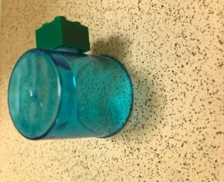
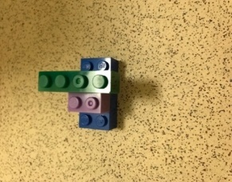
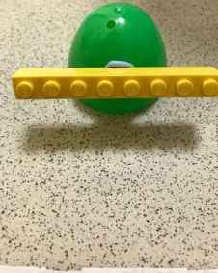
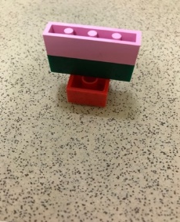
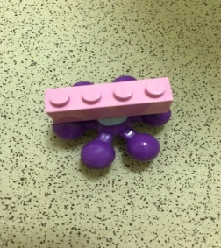
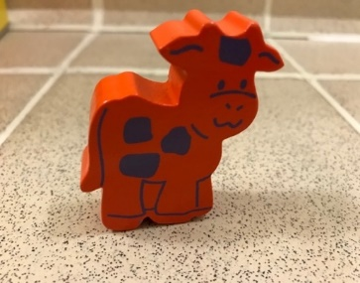
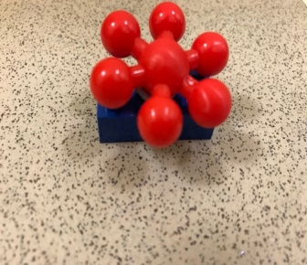
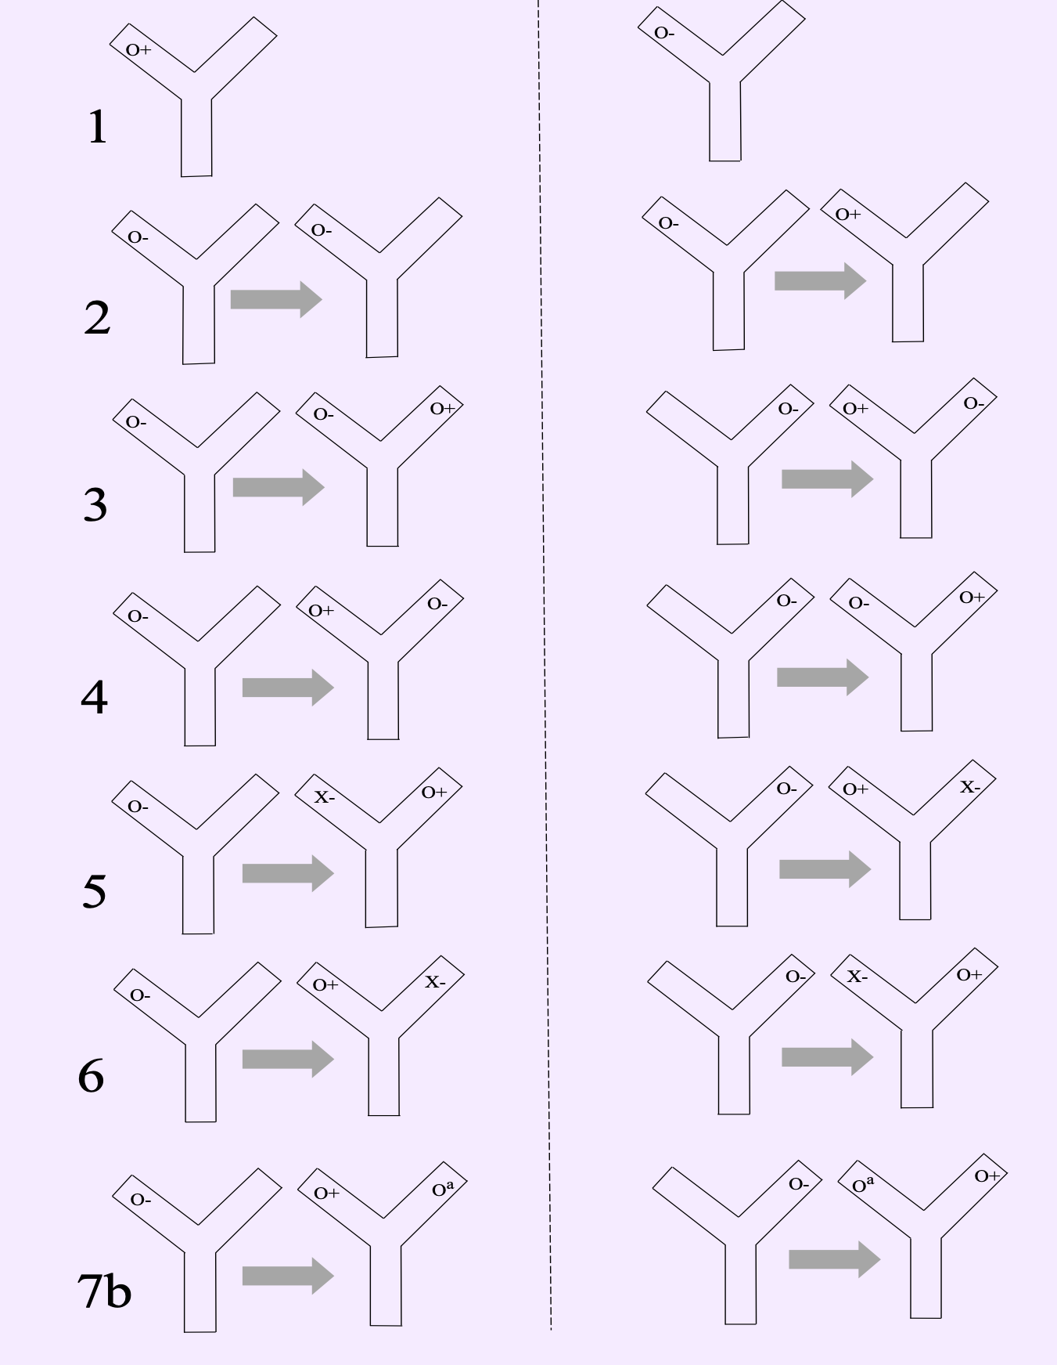
Measuring attention to emotionally salient stimuli in mice using the NOR task
John Gigg, Iasmina Hornoiu and Deborah Talmi
Division of Experimental Neuroscience and Psychology
University of Manchester, UK
Introduction
Results
The Novel Object Recognition (NOR) task is one of the most widely-used paradigms in studies of memory function in rodents. This task relies on the spontaneous drive of rodents to explore novelty in the absence of any training or external reinforcers (Ennaceur and Delacour, 1988; Murai et al., 2007). This ‘allocation of attention’ can be modulated by the emotional value of a stimulus. For example, the odour of female conspecifics triggers arousal and elicits emotional responses in male mice (Beny & Kimchi, 2014). Using a modified NOR task, we tested here whether mice pay more attention to objects labelled with female odour, and quantified the attentional resources that they allocate to them.
Addition of female odour to objects attracts more attention
Expts. 1 and 2. Does odour facilitate exploration?
Study design
Objects with female odour attract more attention regardless of spatial novelty
Mice were approximately 4months old at the start of testing (c57/bl6 males; n=8, expts 1-6; Charles River, UK). A further group of 8 c57/bl6 males aged 4 months males was used for expt 7. Mice were thoroughly habituated to the Y-maze arena and the presence of objects before testing.
Seven experiments were designed, where we measured attention to O+ objects versus copies of the same objects that were labelled with a non-social odour (almond extract, Oª) or no odour (O-), as well as to novel objects (with no odour, X-), which were placed at either novel or familiar locations (Figure 1).
Attention to motivationally-salient O+ objects was compared to that allocated to objects that are salient because of other reasons – either object novelty, location novelty, or both.
Expts. 3 and 4. Does odour in a novel or familiar position facilitate exploration?
Familiar object with female odour outcompetes a novel object for attention only when place in a novel location
Sample of objects
Expts. 5 and 6. Can the addition of odour to a familiar object outcompete a new object (in a novel or familiar position) for exploration?
Expts. 1 and 2.
Does odour facilitate exploration?
Expts. 3 and 4.
Does odour in a novel or familiar position facilitate exploration?
Objects with female odour outcompete objects with a novel odour in a novel location for attention
Expt. 7.
Does novel odour in a novel position outcompete female odour for exploration?
Expts. 5 and 6.
Can the addition of odour to a familiar object outcompete a new object (in a novel or familiar position) for exploration?
Conclusions
Expt. 7.
Does novel odour in a novel position outcompete female odour for exploration?
Objects with female odours attract more attention than odour-neutral objects.
Odour can be more potent than location novelty or object identity in the degree of attention allocation.
The attentional effect of odour is even greater in combination with location or object novelty.
Female odour attracted more attention than a mildly attractive non-social odour.
These results suggest that mice integrate aspects of odour, object novelty and special novelty for motivational salience and that, in some instances, female odour elicits more attention compared to other olfactory stimuli and visual object novelty.
The present study contributes to the understanding of the effects of female odour on male mice attention and provides a reliable protocol for quantifying attention in NOR-like paradigms.
Figure 1: The design of Experiments 1-7.
Data analysis
Exploratory behaviour was recorded with overhead video cameras. Exploration time for each object was scored using the Novel Object Timer software (Jack Rivers-Auty; Novel Object Recognition Task Timer, 2015).
The discrimination index (D2) in Experiments 3-7 was calculated using the formula: D2 = (T_{O+} – T_{Other}) / (T_{O+} + T_{Other});
  T_{O+} : mean exploration time of O+ objects;
  T_{Other} : mean exploration time of O-, Oª or X- objects
-1 ≤ D2 ≤ 1; D2 > 0 : preference for O+; D2 < 0 : preference for other objects; D2 = 0 : no preference (Burke et al., 2010)
The differences in total exploration time of O+, O-, Oª and X- were analysed with paired t-tests (two-tailed). D2 values were analysed with one-sample t-tests.
References
Beny, Y., & Kimchi, T. (2014). Innate and learned aspects of pheromone-mediated social behaviours. Animal Behaviour, 97, 301-311. doi:10.1016/j.anbehav.2014.09.014
Burke, S.N., Wallace, J.L., Nematollahi, S., Uprety, A.R., & Barnes, C.A. (2010). Pattern Separation Deficits May Contribute to Age-Associated Recognition Impairments. Behavioral Neuroscience, 124, 559-573. doi:10.1037/a0020893
Ennaceur A, Delacour J. (1988). A new one-trial test for neurobiological studies of memory in rats. 1. Behavioral data. Behavioural Brain Research; 31, 47–59.
Murai, T., Okuda, S., Tanaka, T., & Ohta, H. (2007). Characteristics of object location memory in mice: Behavioral and pharmacological studies. Physiology & Behavior, 90, 116-124. doi:10.1016/j.physbeh.2006.09.013
Faculty of Biology, Medicine and Health
www.bmh.manchester.ac.uk

